Slide 1
WORK ENERGY
NJ-OER TOPIC-7

Slide 2
Learning Outcomes
recognize the definition of work, kinetic energy and potential energy identify the mathematical quantities which effect the energy and be able to calculate energy of a system distinguish between conservative and non-conservative forces and their effect to transformation of energy determine the total energy change of a system and to state what energy conservation means

Slide 3
Concepts
F = Force d = Displacement θ = Angle between the force and the displacement vector W = Work K=spring coefficient Wnc= Work done by non-conservative forces KE = Kinetic Energy PE = Potential Energy Ei = Initial total energy Ef = Final total energy

Slide 4
Units
SI Units Force is in Newton’s “N” Energy and workdone is in Joules “J” Mass is in kilogram “kg” Angle is in degrees or radian Energy and work done are scalar quantities

Slide 5
Formulas
Definitions W = F.d = F d cos(θ) KE = ½ mv² PEs=½kΔx² or PEs=½ kΔy² or PEs=½ kd² PEg= mgh E=KE+PE=KE+ PEg+ PEs E=½mv²+mgh+½kd² Process Equations If there is no external non conservative forces, then Ef=Ei Ef−Ei=0 or KEi+PEi=KEf+PEf If there are external non conservative forces, then Ef−Ei=WNC or WNC+KEi+PEi=KEf+PEf

Slide 6
KEY STRATEGIES FOR WORK DONE PROBLEMS
Draw a free body diagram, identify forces and the angles
Each force has its own magnitude and angle with respect to the motion
General formula W = F d cos(theta) is always valid for constant force
Perpendicular forces does zero work (theta=90 degrees)
Parallel forces does positive work (theta=0 degrees)
Opposite forces does negative work (theta=180 degrees)
Diagonal forces does work based on their parallel components
W = F(parallel) d
On a diagonal path, forces does work based on the parallel component of displacement
W= F d(parallel)

Slide 7
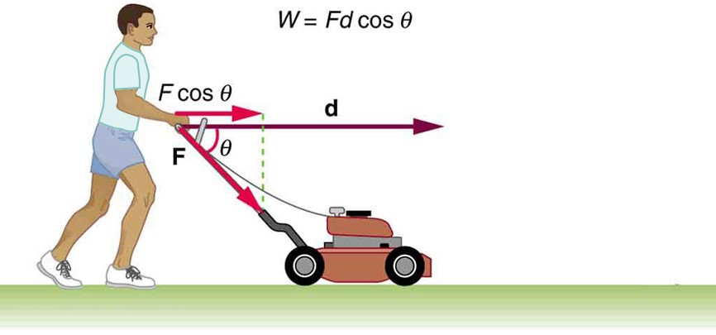
Work Done Model Problem
Q: 1a) How much work is done on the lawn mower by the person in the figure if he exerts a constant force of 75.0N at an angle 60º below the horizontal and pushes the mower 24.0 meters? 1b) How much work is done by the normal force and gravity 1c) There is also friction with magnitude of 20N. What is the work done by the friction.
Hint: Each force has its own magnitude and angle
Work done by external force Work done by gravity and the normal force Work done by the friction
Use 60 degrees as the angle
For this motion, Normal force and the force of gravity are perpendicular which makes theta=90 degrees. cos(90)=0
Friction is the opposing force
for this motion. Which makes theta=180 degrees and workdone negative
Notes:
W = F d cos(theta)
F= 75 N
d= 24 m
Theta=60
W= (75)(24)cos(60)
W =1800 Joules
Cos(180)=-1 f=20 d=24
W=20(24)(-1)=-480
W= -480 J
Friction took energy from the system

Slide 8
CLASSWORK ON WORK DONE
Q) 4.8 Newton's force is applied to move and object 2.5 meters. Find the work done for each of the cases below. First obtain the angle between the force and the displacement by graphing the motion and force.
Force Direction | Displacement Direction | The Angle | Work Done
North | East
45 degrees Northwest | North
-i direction (-x direction) | i direction (+x direction)
20 degrees North of East | 40 degrees South of East

Slide 9
Graphical Interpretation of Work
In a Force vs distance graph, the area under the curve is the work done.
If the area is above the x-axis it counts as positive work
If the area is below the x-axis it counts as negative work
If Force is a piecewise defined function and it is segmented, work done should be calculated for each segment. The sum of the areas gives the net work done

Slide 10
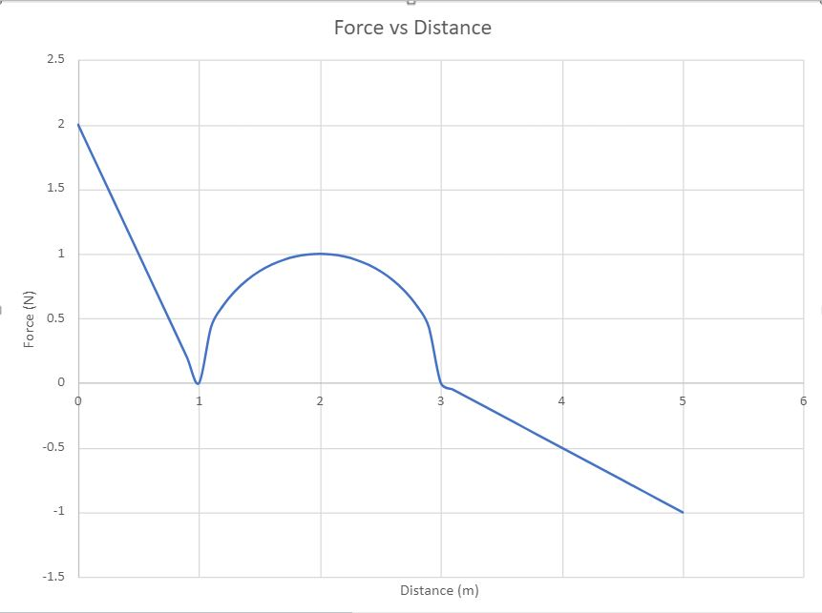
Graphical Interpretation of Work Model Problem
Q2) A variable Force is acting on an object for 5.00 meters. The maximum force is 2.00 Newtons. Force vs distance graph is provided. Find the work done for each segment and find the net work done on the object.
Notes:
W(0-1)= 1 J
W(1-3) = π/2
W(3-5)= -1J
W(net)=π/2
W(net)=1.57 J

Slide 11
WORK ENERY THEOREM
KE = ½ m v²
KEf-KEi = W
½ mvf² – ½ m vi² = Fd cos(theta)

Slide 12
MODEL PROBLEM
Q) A girl with 42kg mass is rode an 8 kg bicycle for 5.0 meters. Her initial speed is 6.0 m/s
A) What is the work done if her final speed is 8.0 m/s?
B) What is the work done if her final speed is 4.0 m/s?
C) Find the average force for each case. Identity the dominant force as force of friction or force of pedaling.
Notes:
SOLUTION A: KEi = ½(50)(6^2)=900J KEF=½ (50)(8^2)=1600J W=1600-900=700J
SOLUTION B: KEi=900J KEF=½(50)(4^2)=400J W=400-900=-500J
SOLUTION C: Favg = W/d Favg=700/5=140N dominant force comes from pedaling for case A
Favg=-500/5=-100N dominant force comes from friction for case B

Slide 13
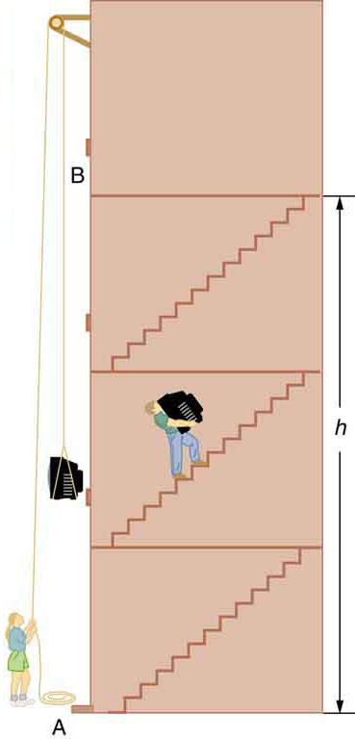
GRAVITATIONAL POTENTIAL ENERGY
Work done for conservative forces can be expressed as potential energy.
Conservative forces are path independent.
The change in gravitational potential energy (ΔPEg) between points A and B is independent of the path.
ΔPEg = mg Δh for any path between the two points.
PEi= m g hi
PEf=m g hf

Slide 14
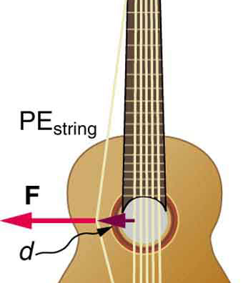
Elastic Potential Energy
Work is done to deform the guitar string, giving it potential energy. When released, the potential energy is converted to kinetic energy and back to potential as the string oscillates back and forth. A very small fraction is dissipated as sound energy, slowly removing energy from the string.

Slide 15
Elastic Potential Energy
Force starts from zero and goes to Fmax=kx, k is the spring constant
So Favg=½ kx and displacement is x. Angle is zero degrees
PEs=½ k x² for horizontal springs
PEs= ½ k y² for vertical springs
PEs=½ k d² for diagonal springs

Slide 16
WORK ENERGY THEOREM CONSERVATION OF ENERGY
W = F.d = F d cos(θ)
KE = ½ mv²
PEs=½ kd²
PEg=mgh
E=KE+PE=KE+ PEg+PEs
E=½ mv²+mgh+½ kd²
Ef=Ei energy is conserved
or Ef-Ei=WNC work is done by nonconservative forces

Slide 17
PROCESS EQUATIONS
When a system goes from an initial state to a final state, initial conditions determines the final state.
Depending on the problem there are two cases
If there are no external forces, nor friction and work done by nonconservative forces is zero then
Ef−Ei=0 or Ef=Ei
KEi+PEi=KEf+PEf
If there are external forces, such as friction or an external push/pull then work done by nonconservative forces is not zero
Ef−Ei=WNC
WNC+KEi+PEi=KEf+PEf

Slide 18
KEY STRATEGIES
Draw the system, identify initial and final states
Using numerical values and variable given in the problem calculate the initial energy
Using numerical values and variables given in the problem calculate or write an expression for the final energy
Using Ef=Ei or Ef-Ei=WNC find the unknown

Slide 19
KEY WORDS THAT IMPLIES NUMBERS
At rest: vi=0 , zero kinetic energy
Stops: vf=0, zero kinetic energy
Hits the ground: hf=0, zero gravitational potential energy
Unstretched spring: zero elastic potential energy
No friction nor external forces: WNC=0, energy is conserved

Slide 20
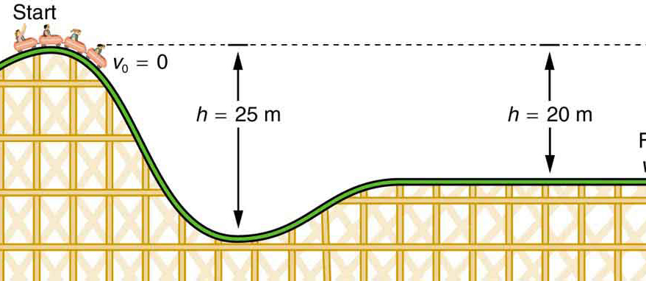
MODEL PROBLEM-ENERGY CONSERVATION
The speed of a roller coaster increases as gravity pulls it downhill and is greatest at its lowest point. Viewed in terms of energy, the roller-coaster-Earth system’s gravitational potential energy is converted to kinetic energy. If work done by friction is negligible, all ΔPE_{g} is converted to KE .
QUESTION: Determine the speed of the roller coaster as it goes down 25.0 meters
Notes:
SOLUTION: Ef=Ei ½ m vf^2 = mg hi Vf=sqrt(g hi) = 15.7 m/s WARNING Vf=sqrt(g hi ) is not valid for all problems

Slide 21
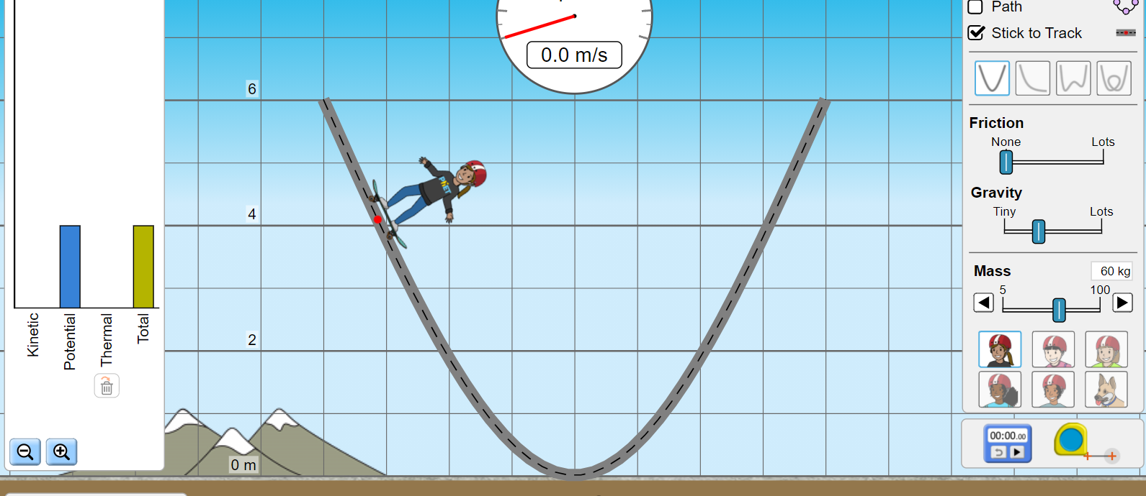
ACTIVITY ENERGY CONSERVATION
Open Phet Skatepark simulation https://phet.colorado.edu/sims/html/energy-skate-park/latest/energy-skate-park_en.html
Click on grid, click on speed, energy and make sure friction is zero
Release the skater at various heights. Estimate the speed at the bottom of the ramp using conservation of energy and compare it with the simulation

Slide 22
ACTIVITY
For each problem below calculate the final velocity numerically and compare it with the simulation.
Q1: A 60kg skater goes down on a frictionless ramp with 4 meters height. Find the velocity at the end of the ramp
Q2: A 50kg skater goes down on a frictionless ramp with 3.5 meters height. Find the velocity at the end of the ramp
Q3: A 60kg skater goes down on a frictionless ramp with 2.5 meters height. Find the velocity at the end of the ramp.
Q4: Change the track and verify that the final speed is path independent. Change gravity and show that vf depends on g
Q4: Come up with your own problem. Solve it numerically and compare it with the simulation.

Slide 23
MODEL PROBLEM: ENERGY CONSERVATION FOR ELASTIC POTENTIAL
A toy car is pushed by a compressed spring and coasts up a slope after it is released. Assuming negligible friction, the potential energy in the spring is first completely converted to kinetic energy, and then to a combination of kinetic and gravitational potential energy as the car rises. The details of the path are unimportant because all forces are conservative
Q) If a 0.25 kg toy car is compressed by 0.4 meters by a spring with a spring constant k=20N/m and released. What would be its speed at the elevation of 0.16 meters.
Notes:
Ei =½ m vi^2 + mghi + ½ k xi^2 vi=0 hi=0 xi=0.4 k=20 m=0.25 Ei= ½ (20)(0.4^2)=1.6 J
Ef = ½ m vf^2 + mghf + ½ k xf^2 vf=? hf=0.16 xf=0 since he spring uses all its energy to push.
Ef=½ mvf^2+(0.25)(9.8)(0.16)
Ef=Ei 1.6=½ (0.25)(vf^2)+0.4 Vf= 3.1 m/s

Slide 24
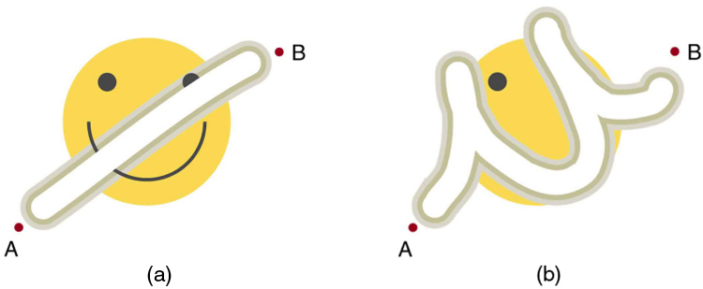
NON CONSERVATIVE FORCES-FRICTION
The amount of the happy face erased depends on the path taken by the eraser between points A and B, as does the work done against friction. Less work is done and less of the face is erased for the path in (a) than for the path in (b). The force here is friction, and most of the work goes into thermal energy that subsequently leaves the system.
Energy is lost WNC is NEGATIVE

Slide 25
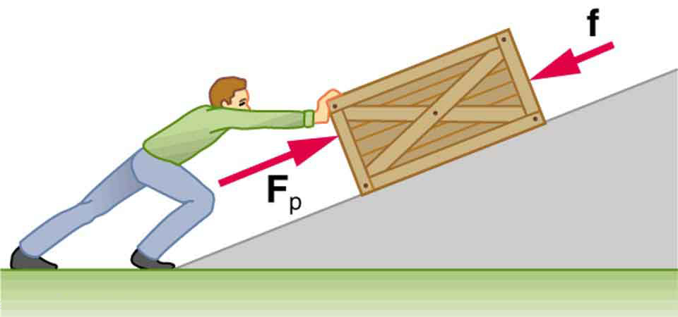
NON-CONSERVATIVE EXTERNAL FORCES
A person pushes a crate up a ramp, doing work on the crate. Friction and gravitational force (not shown) also do work on the crate; both forces oppose the person’s push. As the crate is pushed up the ramp, it gains mechanical energy, implying that the work done by the person is greater than the work done by friction.

Slide 26
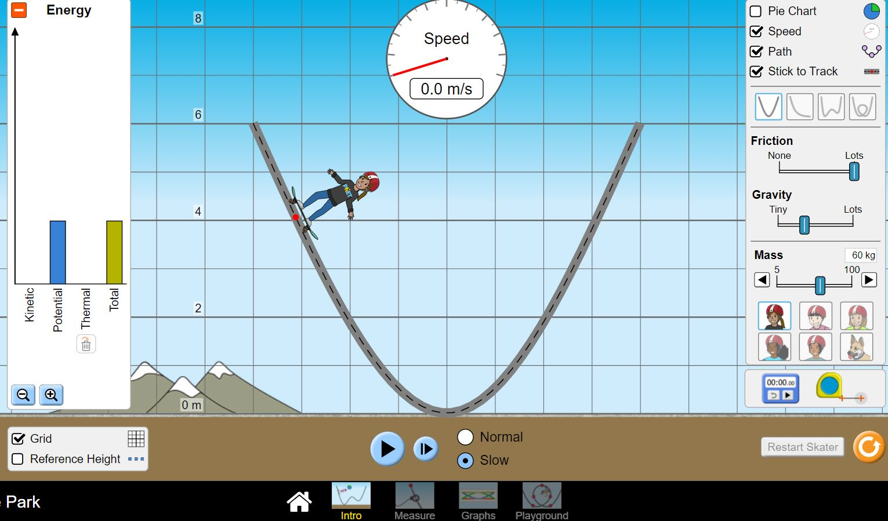
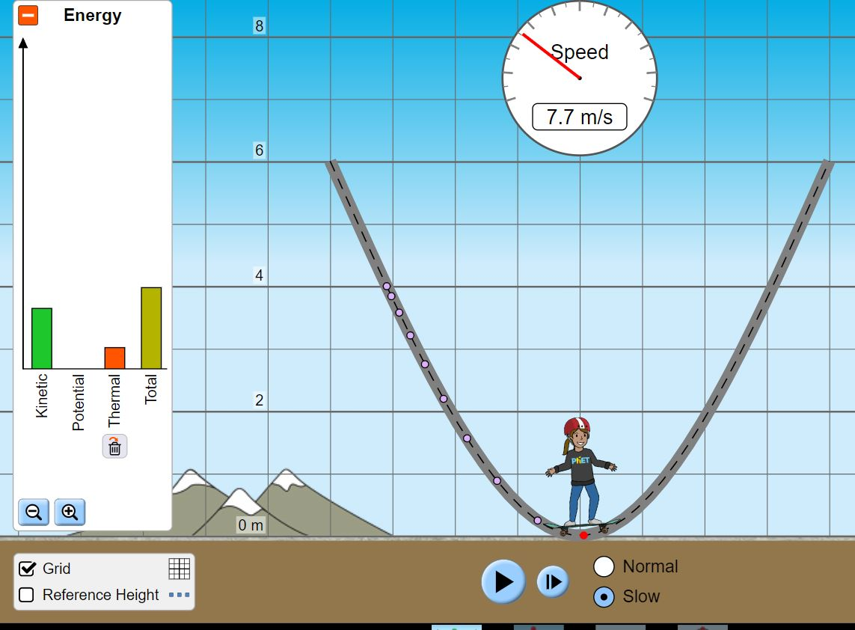
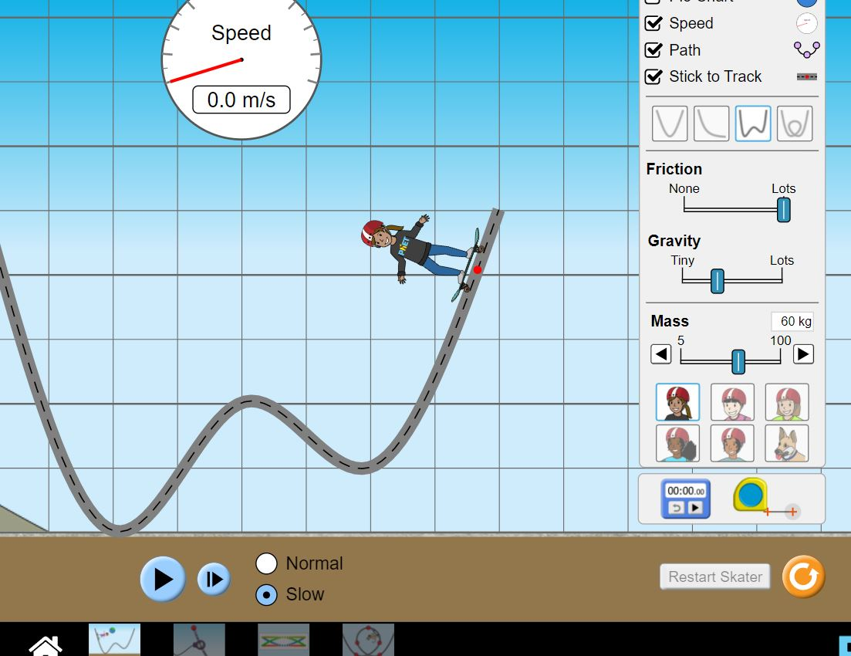
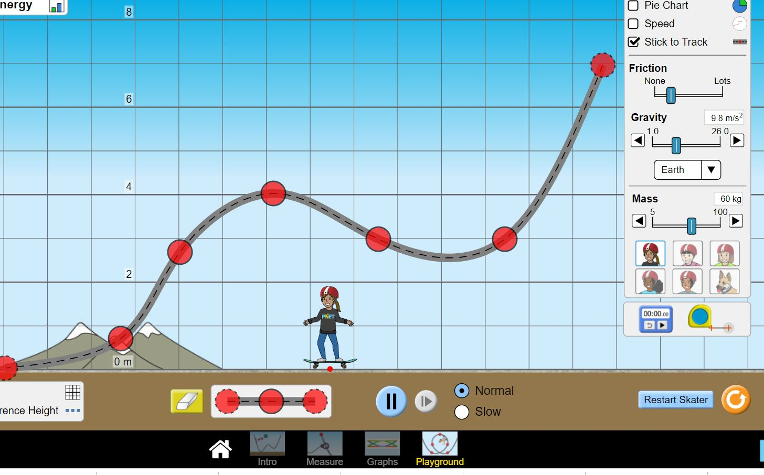
ACTIVITY WNC DUE TO FRICTION
Open Phet Skatepark simulation https://phet.colorado.edu/sims/html/energy-skate-park/latest/energy-skate-park_en.html
Click on grid, click on speed, energy and make sure friction is NOT ZERO
Release the skater at various heights. Measure the speed using the speedometer
Find the work done by non-conservative forces
For enhancement activity try to calculate the average friction force and the coefficient of friction. The parabolic track can be approximated as a diagonal path with 53 degrees slope. Use W=-f d and f=mu N

Slide 27
ACTIVITY WNC DUE TO FRICTION
For each problem measure the final velocity and calculate the work done by friction. Try to estimate the average force afterwards.
Q1: A 60kg skater goes down on a ramp with friction from 4 meters height. Measure its final velocity and calculate WNC
Q2: A 50kg skater goes down on a ramp with lots of friction from 3.5 meters height. Measure its final velocity and calculate WNC
Q4: Change the track, verify that the final speed DEPENDS on the path. Obtain the final speed for each track, find WNC
Q4: Build your own track using the playground option with some friction. Investigate the path dependence of vf.

Slide 28
POWER
Power is the rate of applied or dissipated energy
P= E/t
P=W/t
Power has SI unis of J/s or Watts
If an object moves with constant speed against friction, there should be an external applied force
P = F v

Slide 29
MODEL PROBLEM
Q: A conveyer belt moves a box horizontally with 0.40 m/s speed using a machine with 10 Watts output.
A) Find the average applied force.
B) Find the force of friction
C) Find the energy consumption if the machine is operated for one minute. Verify that this energy matches with the work done by the force for moving an object with 0.40 m/s speed for 60 seconds. Find "d" first.
Notes:
Solution :
A) P = F v P=20W v = 0.40 m/s Fapplied=? 20=F (0.40) F=50N
B) Friction=-50N in x-direction or friction=50N in the opposite direction
C) E = P.t Energy=10(60)= 600 J

Slide 30
REFERENCES
Open Stax
Physics Classroom
Adobe stock photo
PhET

